Slide 1
Metallic Glass
tong
2014-12-19

Slide 2
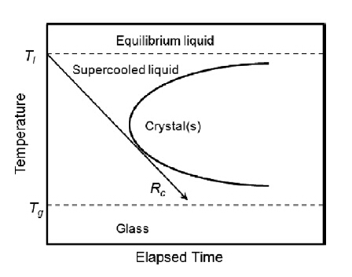
Introduction
Metals are made of metallic elements via metallic bonding with long-range translational order.
Glasses involve covalent and ionic bonds, or van der Waals interaction, and are characterized by an amorphous structure without long-range structural correlation.
In 1960s, the first MGs (Au₇₅Si₂₅) were synthesized, overlapping these two categories of materials.

Slide 3
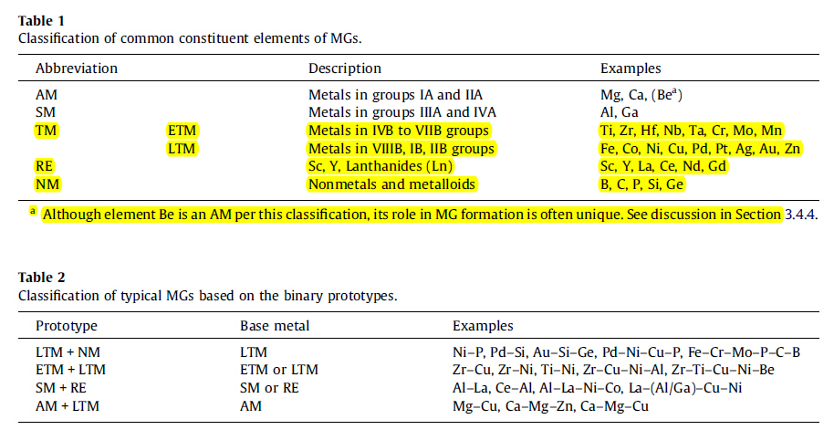
Introduction: formation and classification
Glasses are essentially ‘‘frozen’’ liquids made by quenching of their high temperature melts.
The first MG sample was obtained at cooling rates 10⁵-10⁶K/s

Slide 4
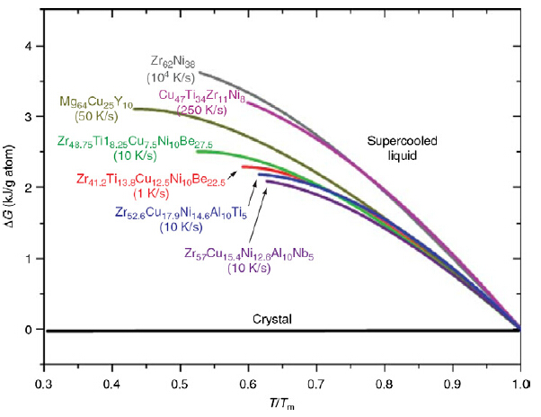
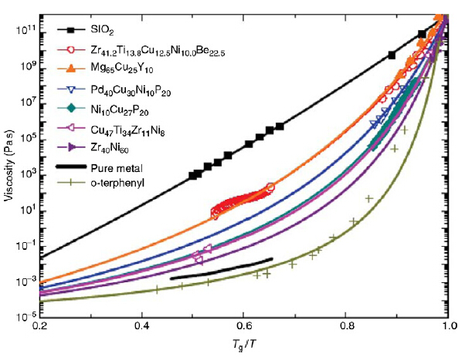
Introduction: formation and classification
ΔG VS Viscosity(η)
Not for MGS

Slide 5
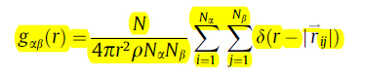
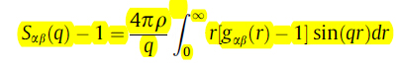
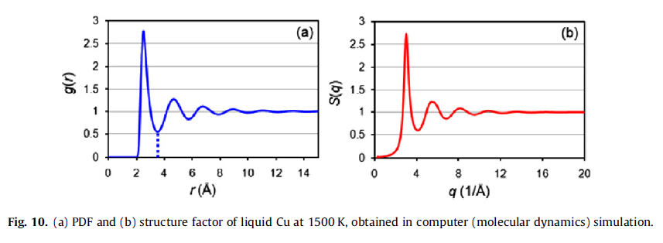
Structure characterization of metallic glasses
Pair distribution function
Structure factor

Slide 6
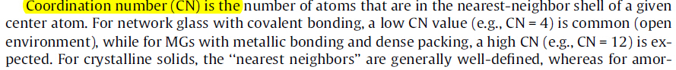
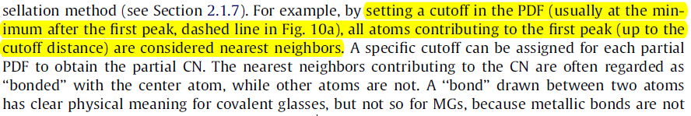
Structure characterization of metallic glasses
Coordination Number

Slide 7
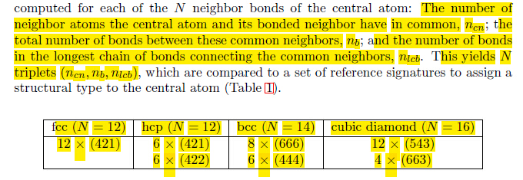
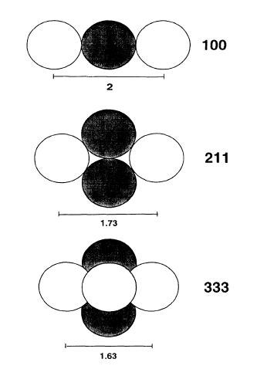
Structure characterization of metallic glasses
Common Neighbor Analysis

Slide 8
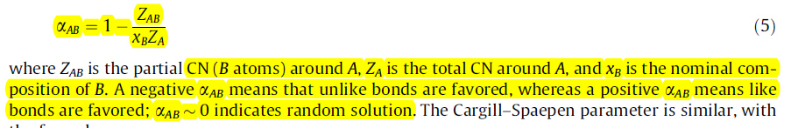
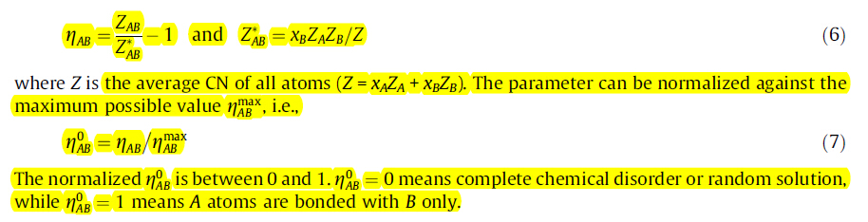
Structure characterization of metallic glasses
Chemical Short-range Order

Slide 9
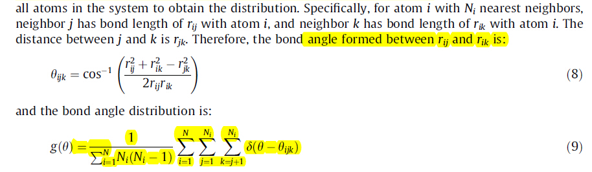
Structure characterization of metallic glasses
Bond Angle Distribution

Slide 10
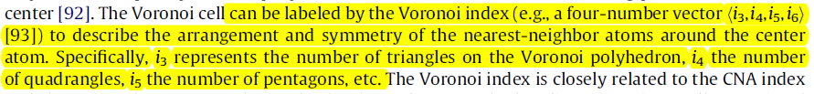
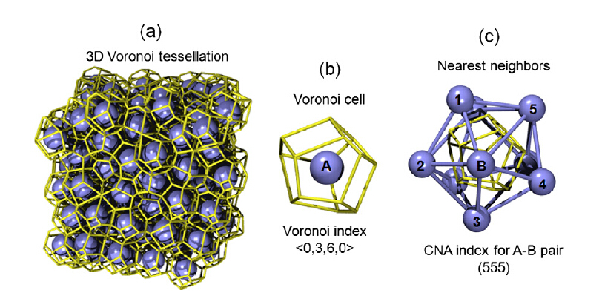
Structure characterization of metallic glasses
Voronoi Tessellation

Slide 11
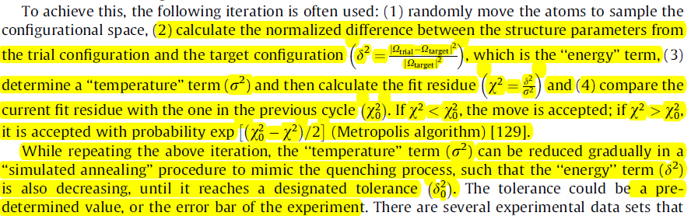
Computational Methods
Reverse Monte Carlo modeling (RMC)

Slide 12
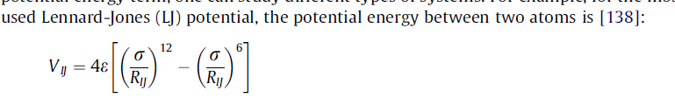
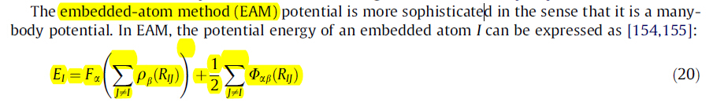
Computational Methods
Molecular dynamic simulation (MD)

Slide 13
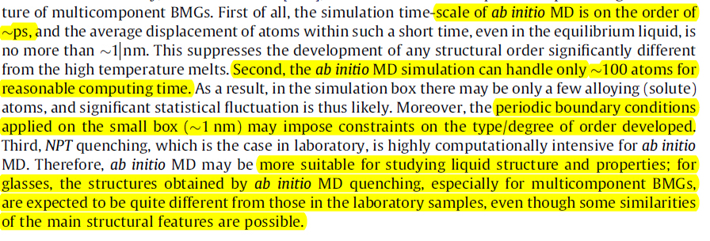
Computational Methods
Quantum Molecular dynamic simulation (MD)

Slide 14
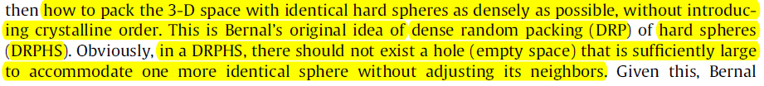
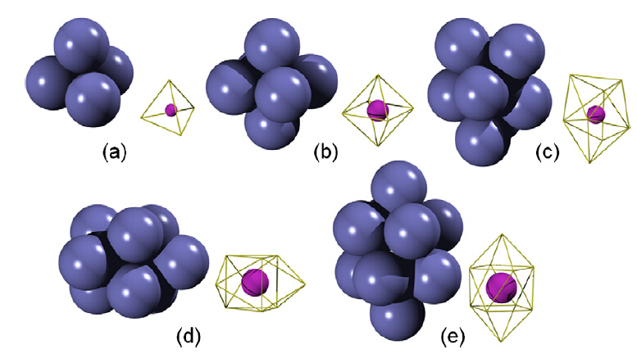
Atomic-level structure of metallic galsses
Structure of monatomic liquids
Dense random packing of hard spheres (DRPHS model)

Slide 15
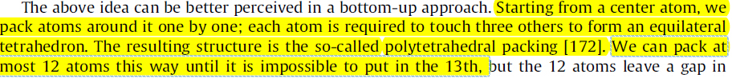
Atomic-level structure of metallic galsses
Structure of monatomic liquids

Slide 16
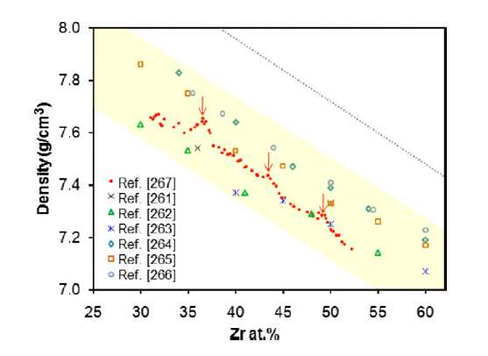
Atomic-level structure of metallic galsses
Structure of Cu-Zr binary metallic glasses

Slide 17
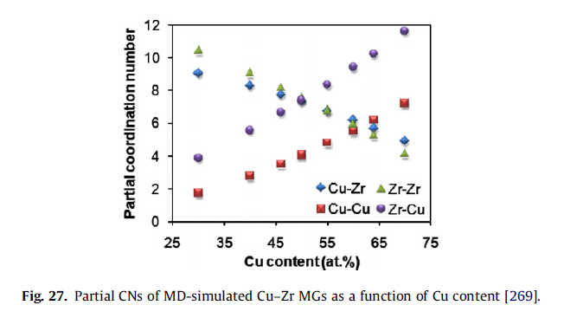
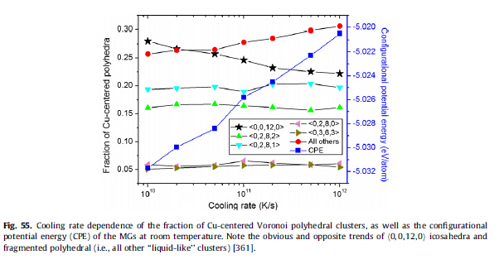
Atomic-level structure of metallic galsses
Structure of Cu-Zr binary metallic glasses

Slide 18
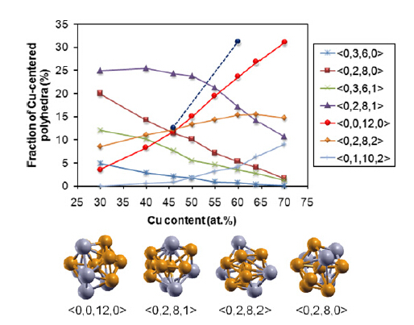
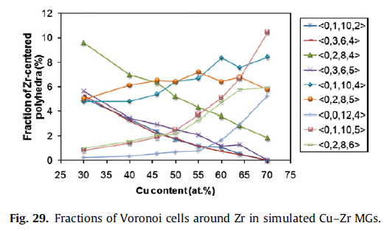
Atomic-level structure of metallic galsses
Structure of Cu-Zr binary metallic glasses

Slide 19
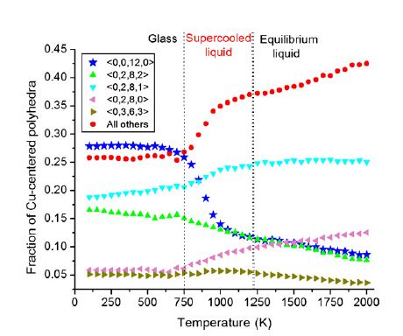
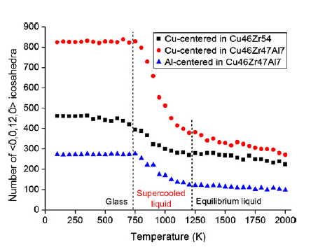
Atomic-level structure of metallic galsses
Structure of Cu-Zr binary metallic glasses

Slide 20
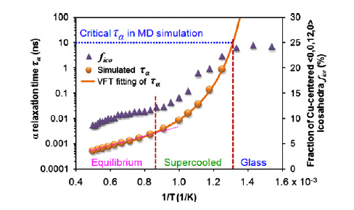
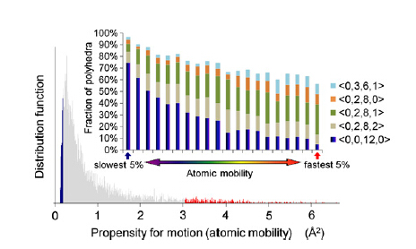
Atomic-level structure of metallic galsses
Structure of Cu-Zr binary metallic glasses

Slide 21
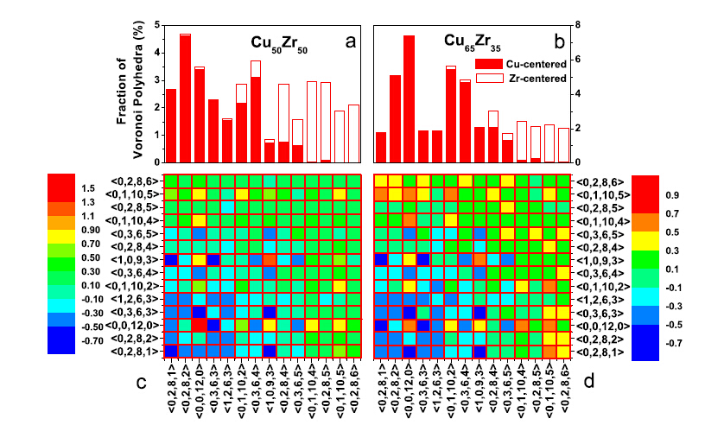
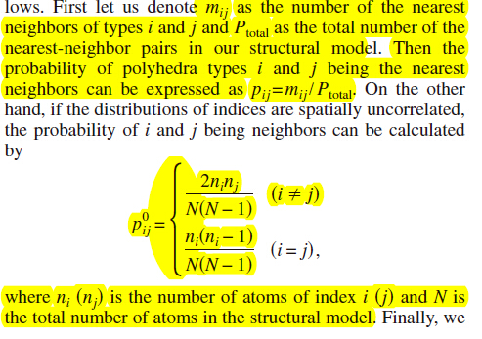
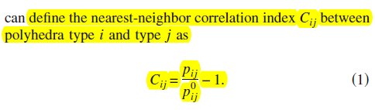
Atomic-level structure of metallic galsses
Structure of Cu-Zr binary metallic glasses

Slide 22
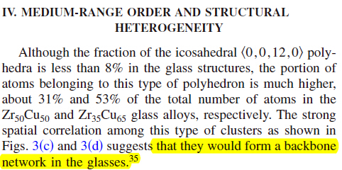
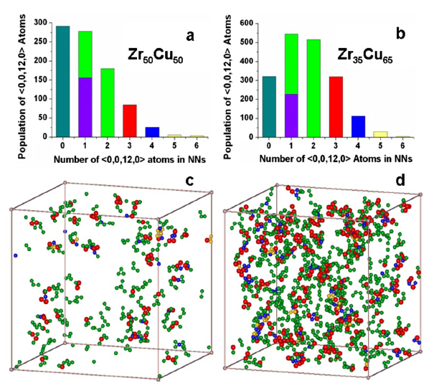
Atomic-level structure of metallic galsses
Structure of Cu-Zr binary metallic glasses

Slide 23
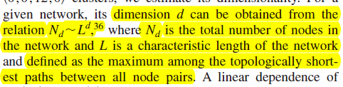
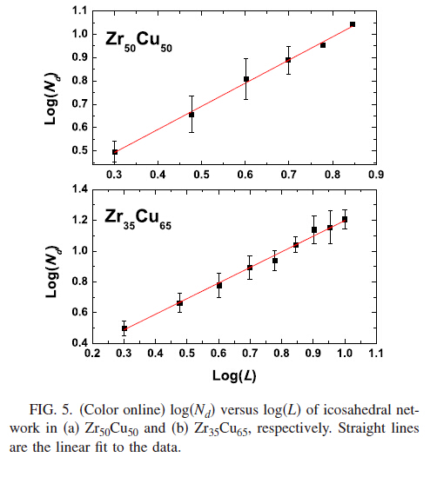
Atomic-level structure of metallic galsses
Structure of Cu-Zr binary metallic glasses

Slide 24
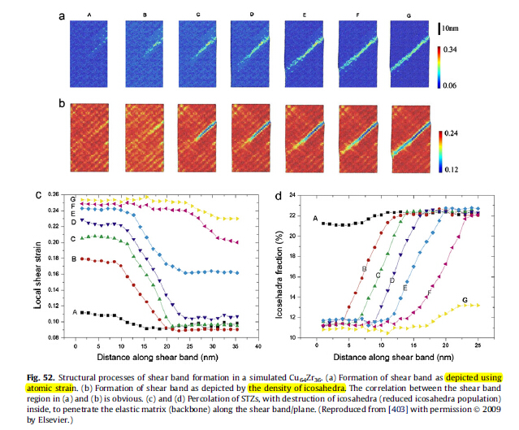
Atomic-level structure of metallic galsses
Structure of Cu-Zr binary metallic glasses

Slide 25
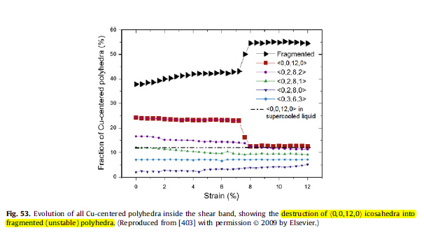
Atomic-level structure of metallic galsses
Structure of Cu-Zr binary metallic glasses

Slide 26
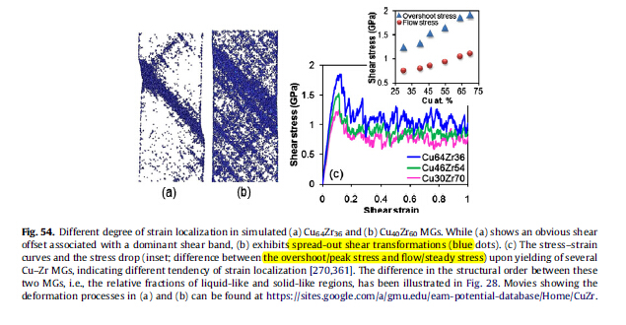
Atomic-level structure of metallic galsses
Structure of Cu-Zr binary metallic glasses

Slide 27
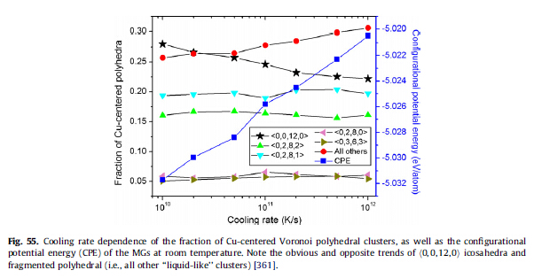
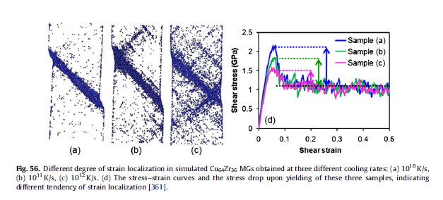
Atomic-level structure of metallic galsses
Structure of Cu-Zr binary metallic glasses

